Slide 1

Modeling and Simulation of Satellite Servicing Manipulators
ENPM 662 - Final Project
Presentation
Adarsh Malapaka
118119625
Sai Sandeep Adapa
118411460
7 December, 2021

Slide 2
Introduction
Satellite servicing on orbit is complicated by several factors primarily because nearly all satellites don't have the ability to service themselves.
Servicing involves cutting and partially removing the protective thermal blanketing prior to servicing a satellite operation.
Long telemetry delays between satellites, limited and obstructed views through the camera are some of the challenges faced by the Earth-based operator.
Despite the limitations, utilizing satellite servicing robots can bring down the cost of a space mission by enhancing the orbital lifetime of the designated satellites.
The applications are not only limited to Satellite Servicing but can also be extended to implement space junk cleaning missions.
Our orbit is filled with debris, including chunks of dead satellites & discarded rockets.
The Satellite servicing model can be used to latch onto debris before diving back down to Earth, where both machine and junk will burn up in the atmosphere.

Slide 3
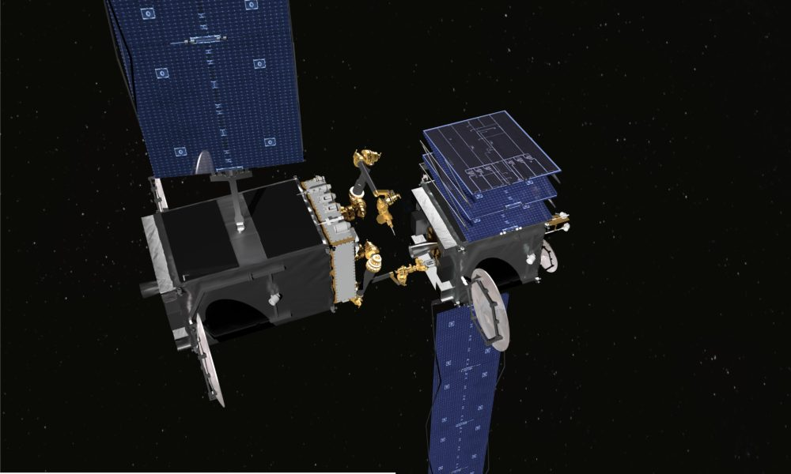
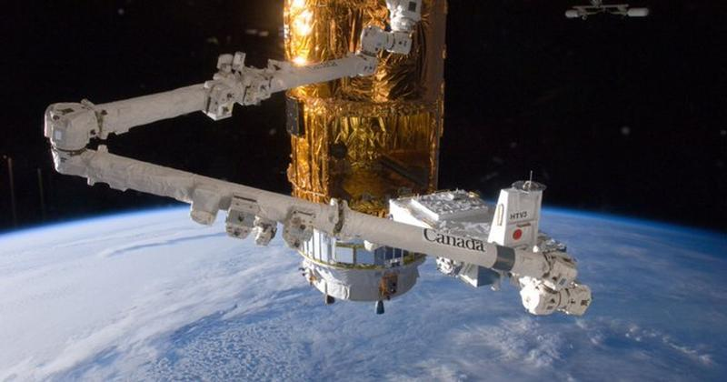
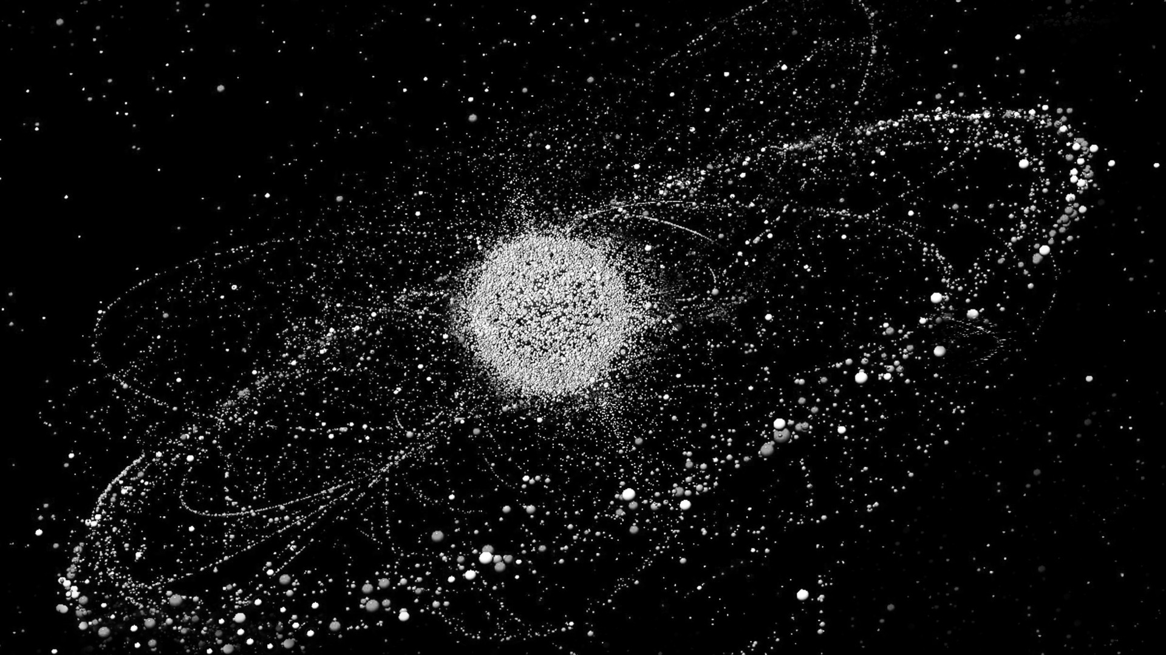
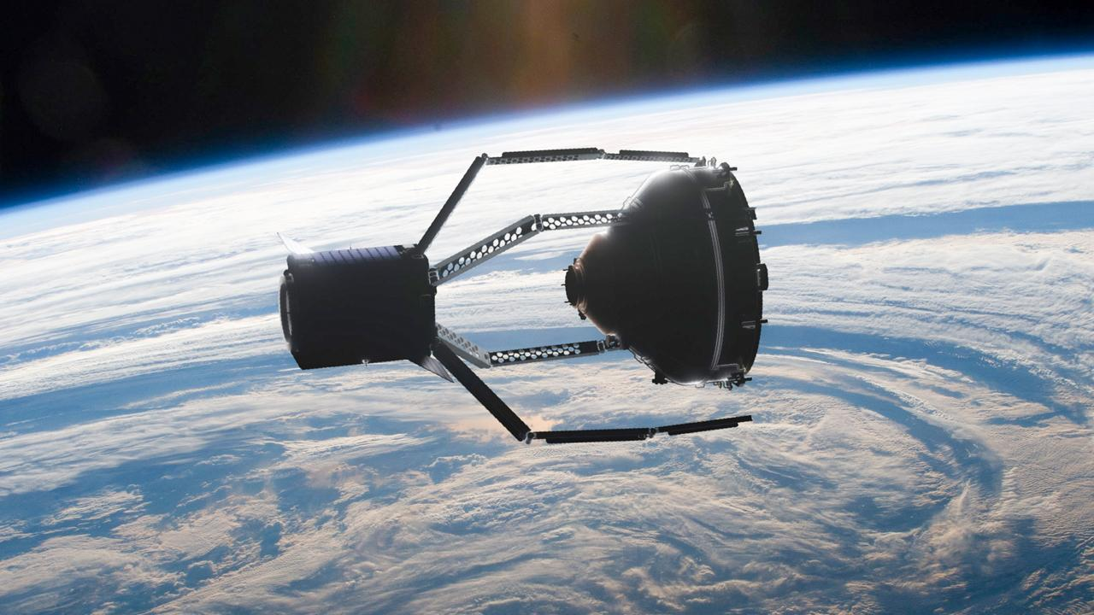
Fig : MDA
Fig : DARPA
Fig : Earth Debris
Fig : Space Claw

Slide 4
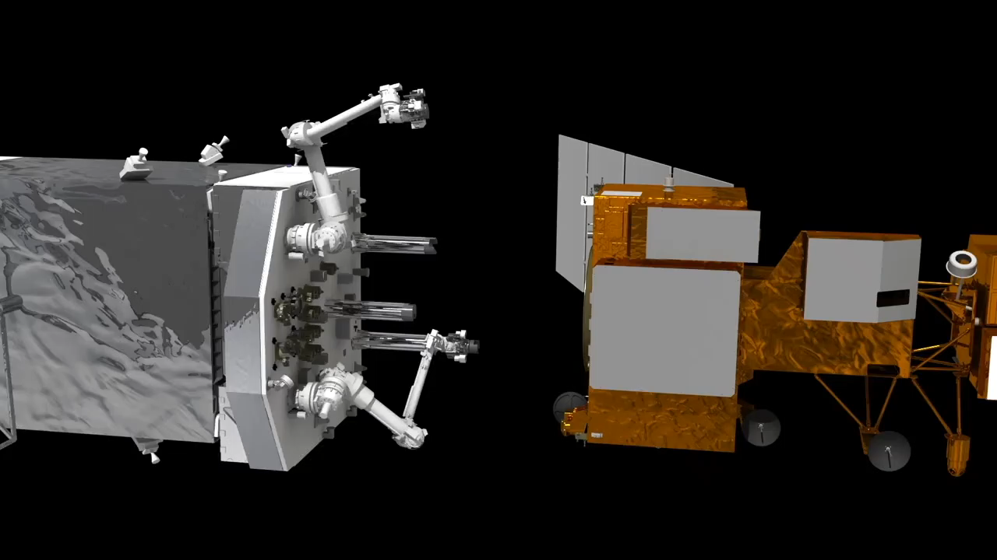
Restore-L Mission Concept

Slide 5
Motivation
The world-famous Hubble Telescope launched on April 24, 1990, had to undergo 5 Service missions in its lifetime. The service cost for each mission was humongous and required astronauts to risk spacewalks to repair the telescope.
In 1996, a French satellite was hit and damaged by debris from a French rocket that had exploded a decade earlier.
On Feb. 10, 2009, a defunct Russian spacecraft collided with and destroyed a functioning U.S. Iridium commercial spacecraft which added more than 2,300 pieces of trackable debris.
China’s 2007 anti-satellite test, which used a missile to destroy an old weather satellite, added more than 3,500 pieces of trackable debris.

Slide 6
Project Process
FK and IK of the robot arms were derived using the DH convention and were validated using the Robotics Toolbox by Peter Corke in MATLAB.
Using the actual ERA (European Robotic Arm) with appropriate scaling, CAD model was designed in SolidWorks.
After designing the arm, it was mounted to the service satellite, followed by assigning global coordinate frames to each joint from the DH parameters calculation and later the URDF file + package were generated.
A Xacro file was written to incorporate the two gazebo camera plugins (viewed in RViz) along with the necessary effort_controllers (position control) for the joints.
Two ROS python files are written where one was to teleop the robot arm using joint_state_publisher gui and the other to move to certain predefined points.
At this point, to simulate round-trip time delay between earth and outer space, a 5-7
second time delay ROS node was implemented to better simulate reality of space.

Slide 7
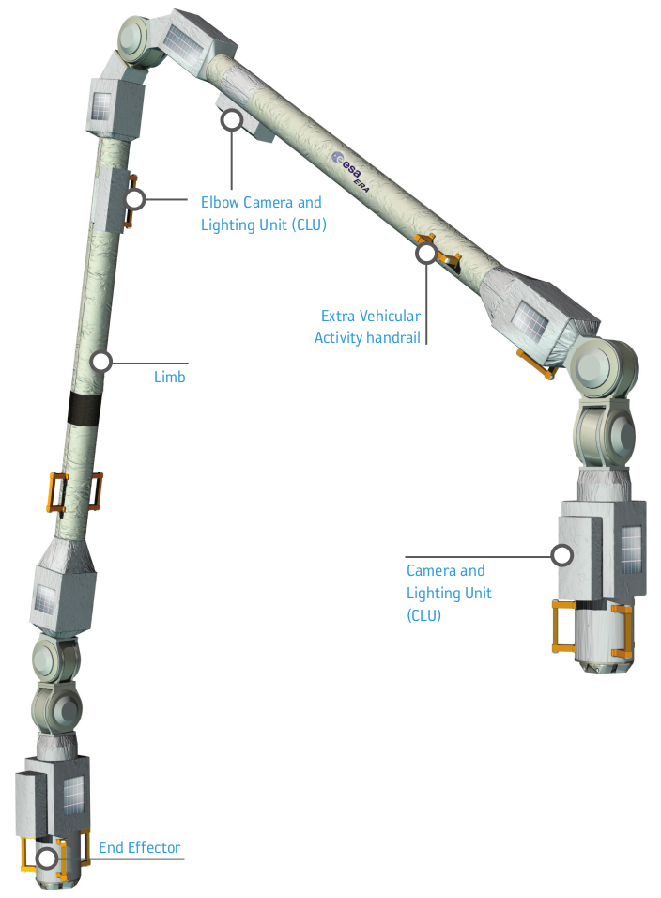
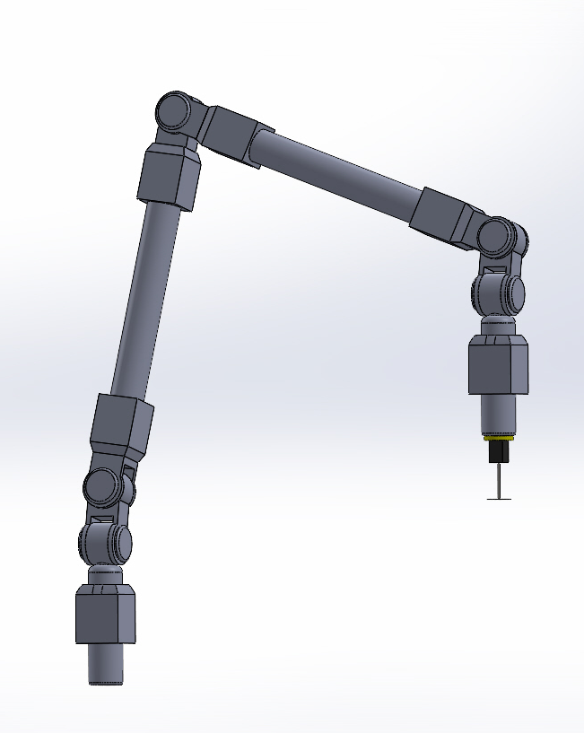
Robot Model (Arm Only)
7 DoF robot arm
(3 in the base + 1 in the elbow + 3 in the wrist)
6 DoF robot arm
(3 in the base + 1 in the elbow + 2 in the wrist)
Total Length: 11,300 m
Total Length: 5,006 m
(Dimensions and other dynamic properties scaled down for simulation purposes)
Actual Model of the
European Robotic Arm (ERA)
Custom designed Replica CAD Model (with cutter attached)

Slide 8
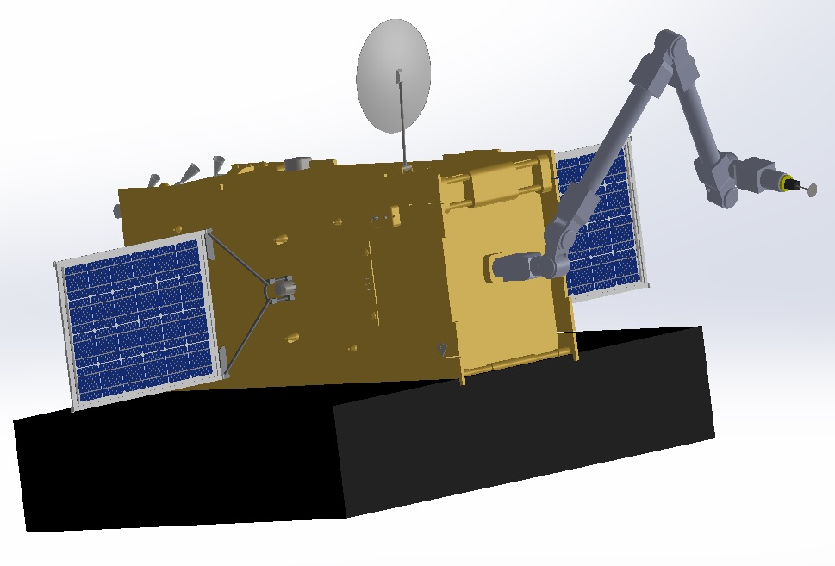
Robot Model (Arm on Satellite Setup)
The ERA CAD model mounted on an assembly consisting of a CAD model of a Turkish Satellite in SolidWorks to represent the servicing satellite, taken from the Internet and modified to suit our design requirements.
This satellite CAD model was also for the satellite to be serviced in the Gazebo environment.
Satellite CAD Model Source

Slide 9
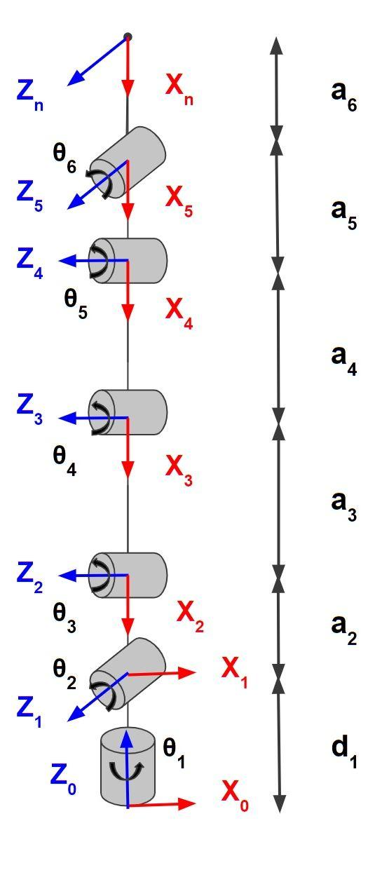
Robot Kinematics (DH Table)
Link ‘i’ | theta | d | alpha | a
1 | θ₁* | d₁= 0.577m | 90 deg | 0
2 | θ₂*- 90 | 0 | 90 deg | -a₂ = -0.224m
3 | θ₃* | 0 | 0 deg | -a₃= -1.572m
4 | θ₄* | 0 | 0 deg | -a₄= -1.572m
5 | θ₅* | 0 | -90 deg | -a₅= -0.224m
6 | θ₆* | 0 | 0 deg | -a₆= -0.577m
Frame {n} represents the end of the robot arm and does not include the cutter assembly. Hence, a₆ is the length of the end effector before the cutter. The cutter apparatus is 0.260 m in length.

Slide 10
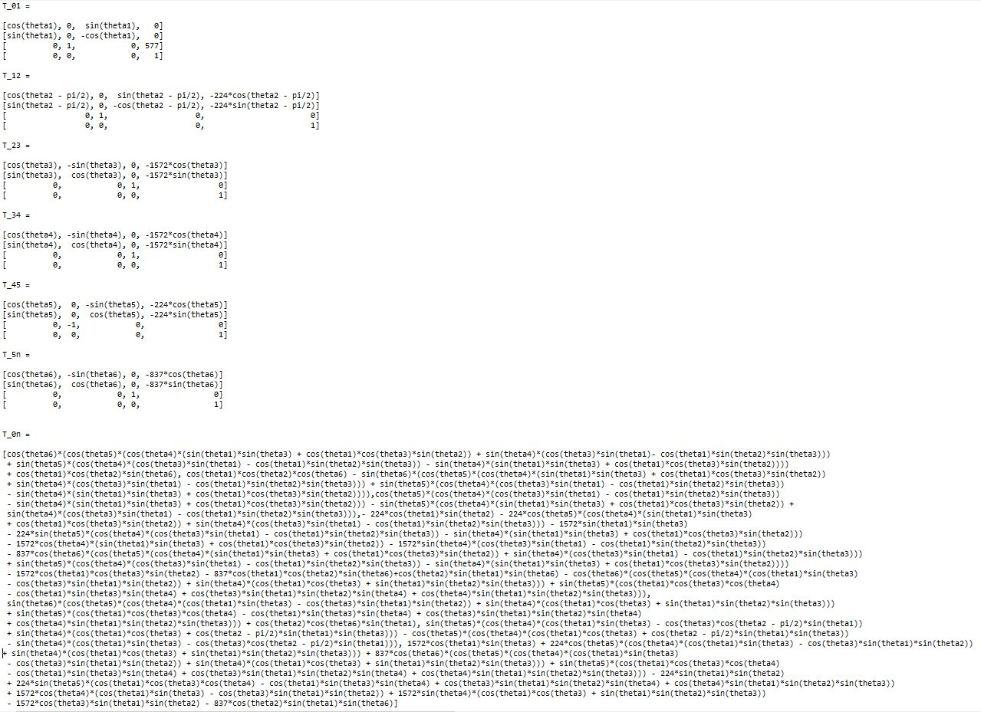
Robot Kinematics (FK Equations)

Slide 11
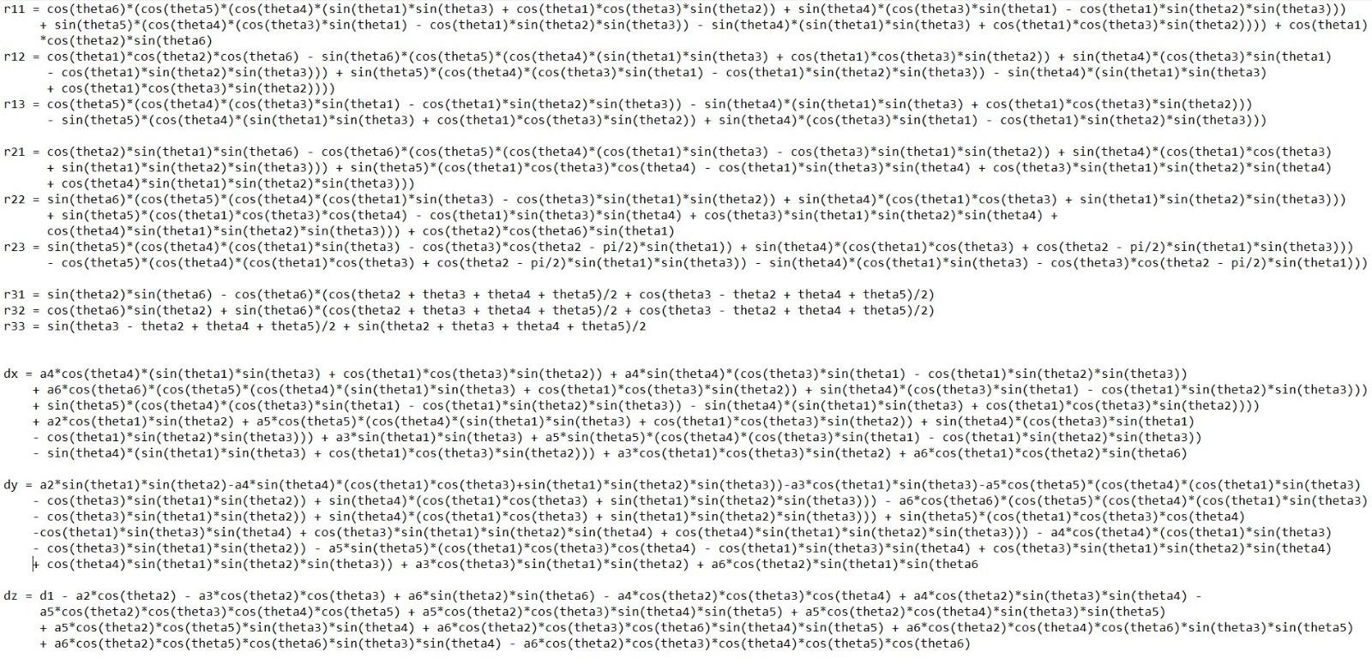
Robot Kinematics (IK Equations)
The above 12 non-linear trigonometric equations are numerically solved to obtain the respective joint angles from the given end-effector pose values.

Slide 12
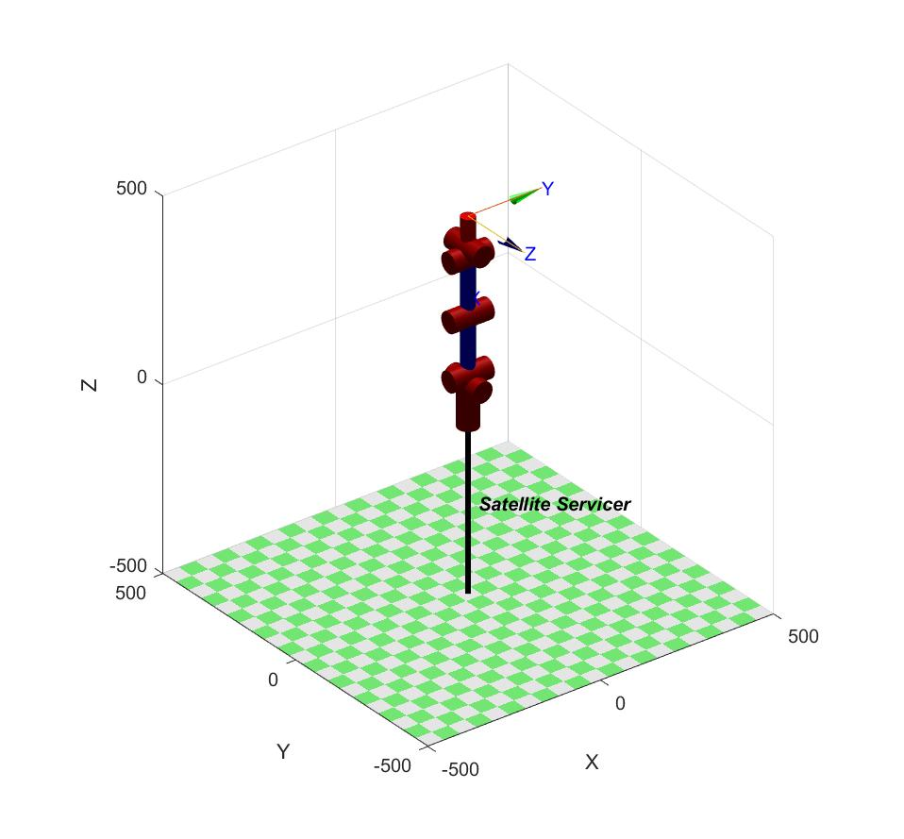
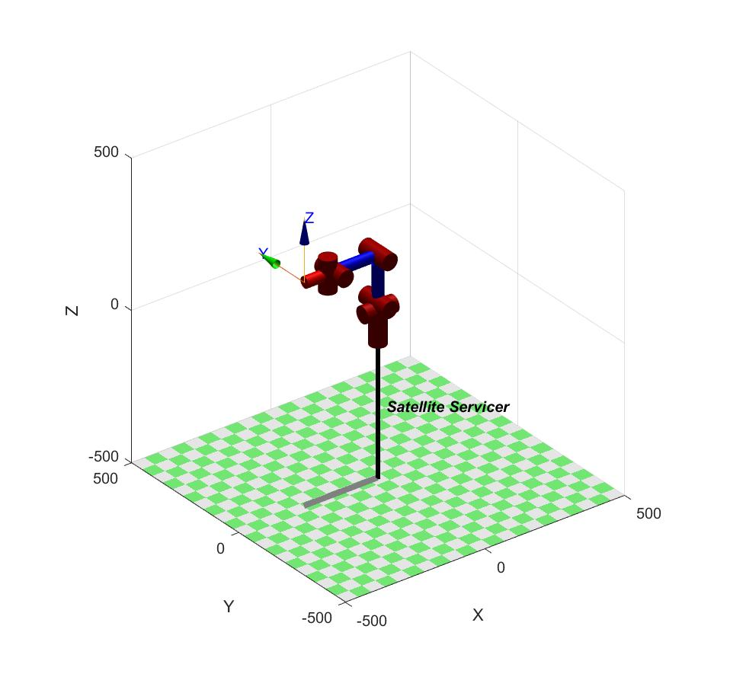
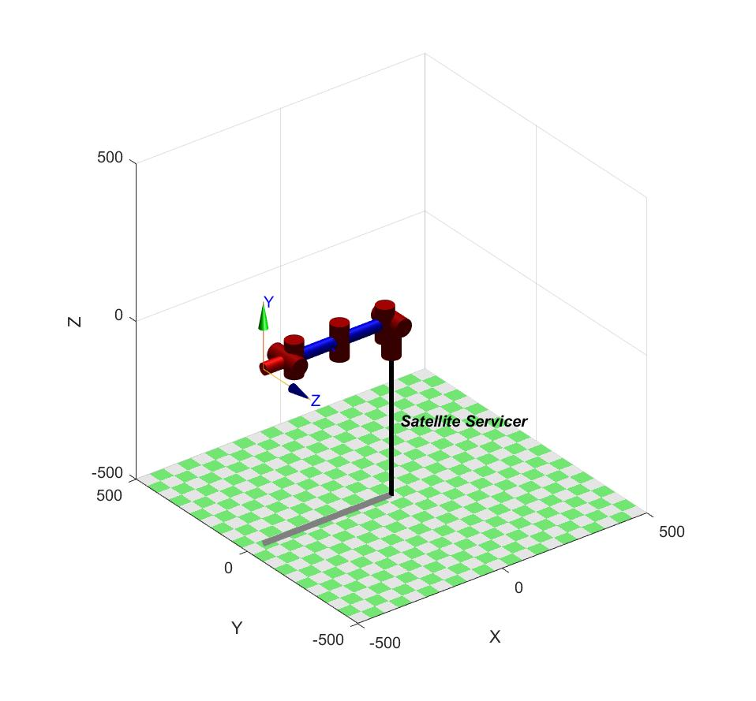
Robot Kinematics (FK & IK Validation)
Case 2: q2 = 90, other angles = 0
Case 1: All Joint angles = 0
Case 3: q1, q4 = 90, other angles = 0
Using MATLAB Robotics Toolbox (Peter Corke)

Slide 13
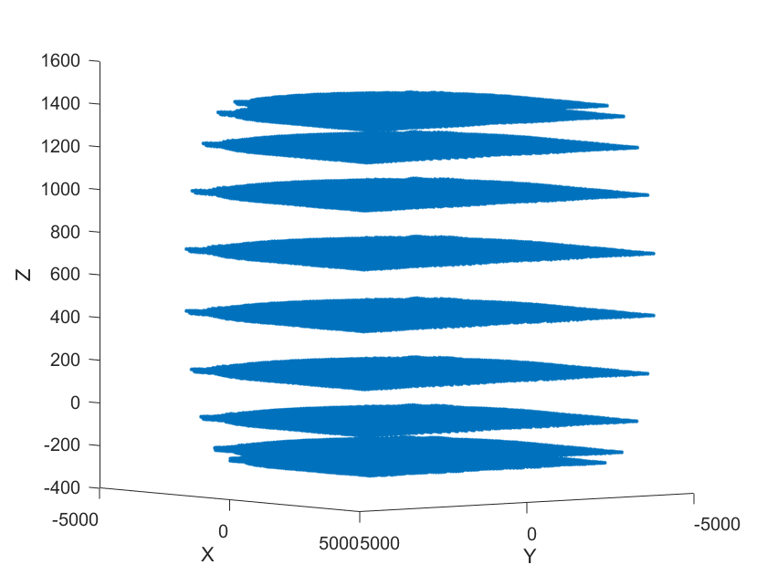
Robot Workspace

Slide 14
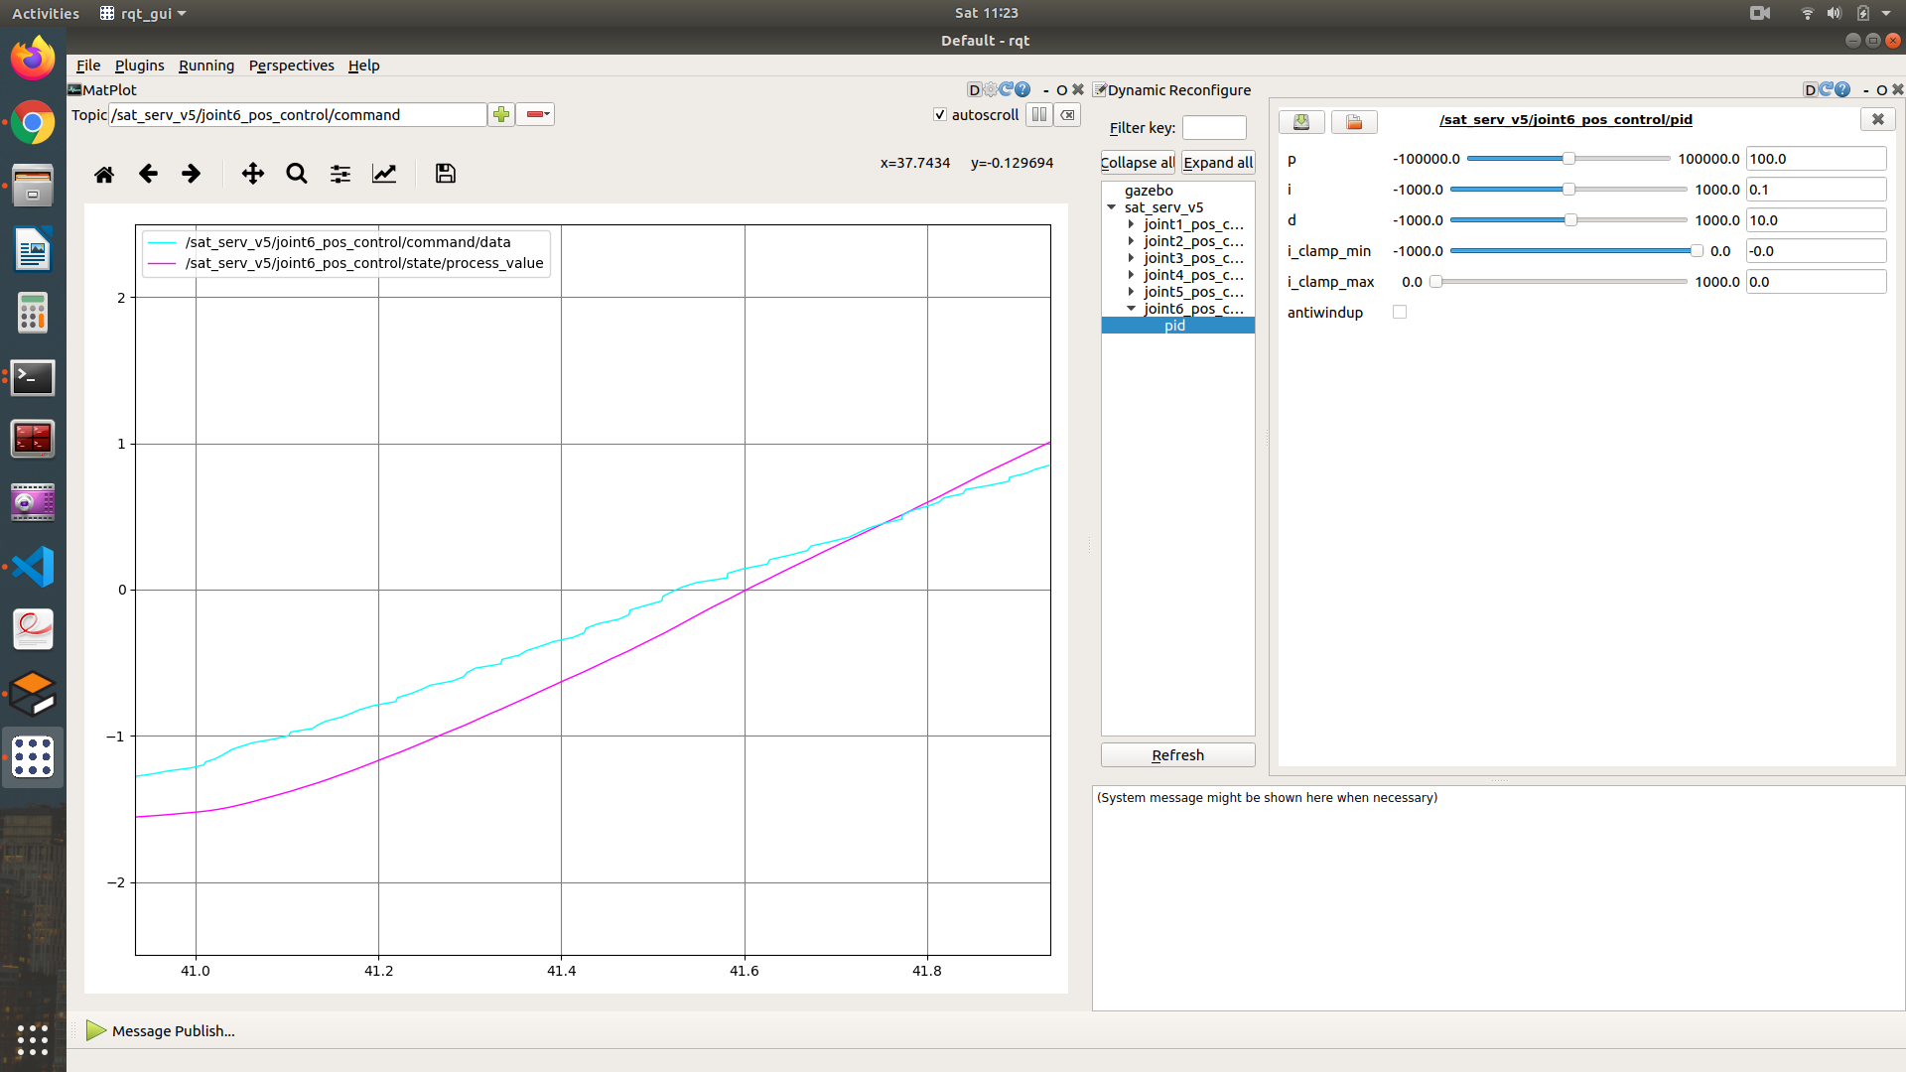
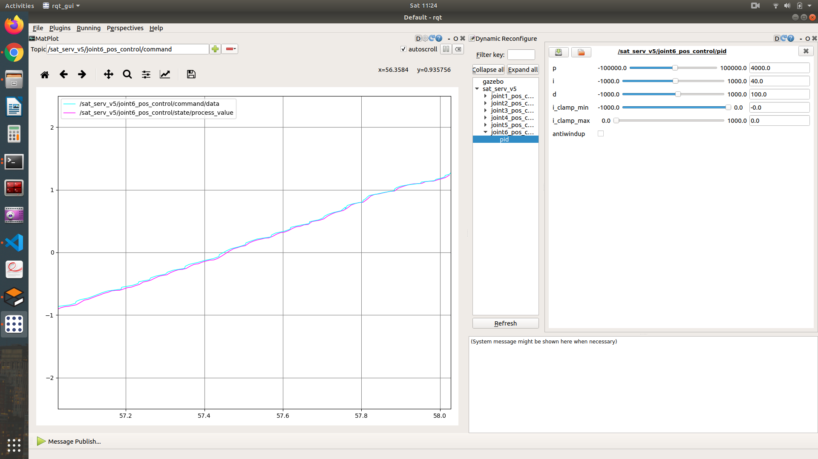
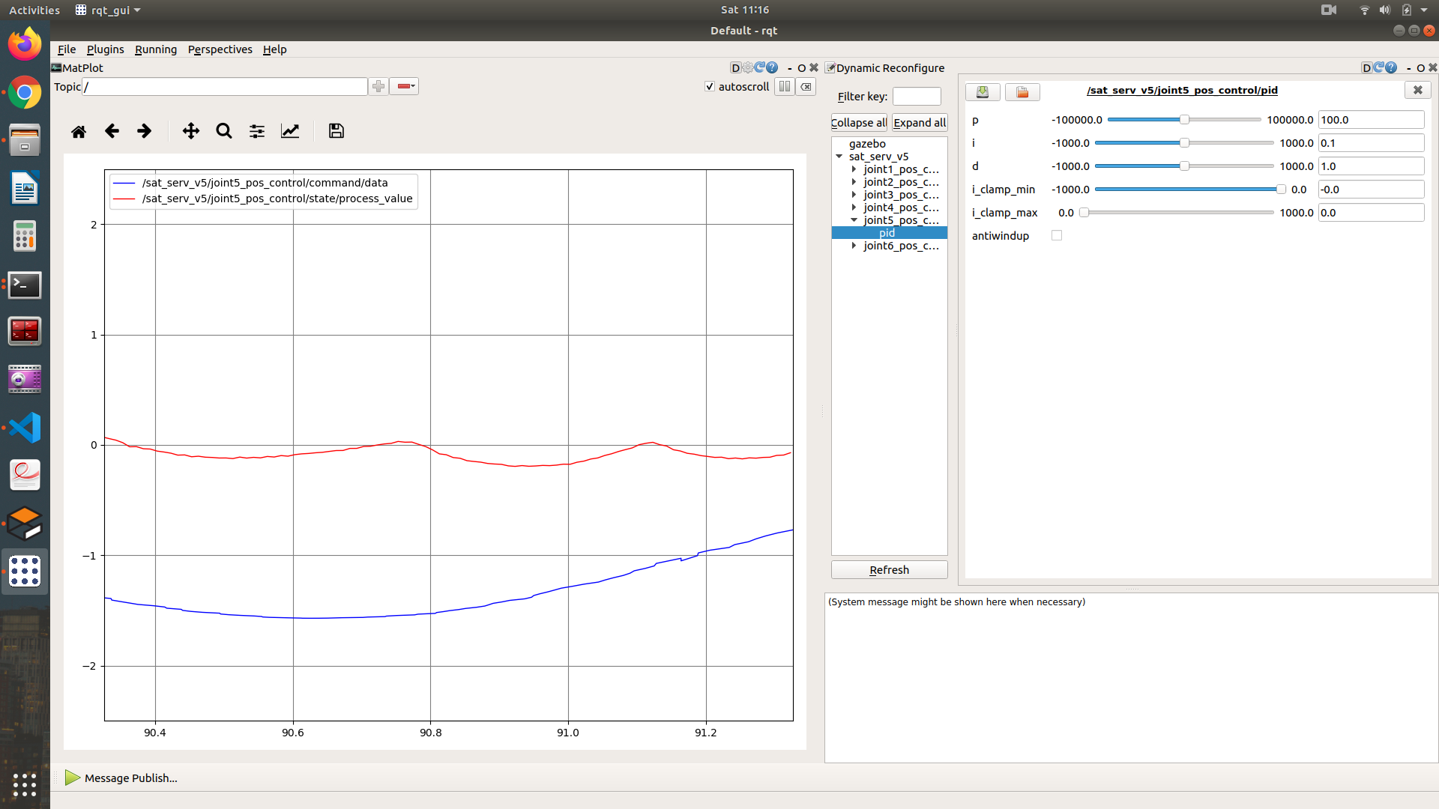
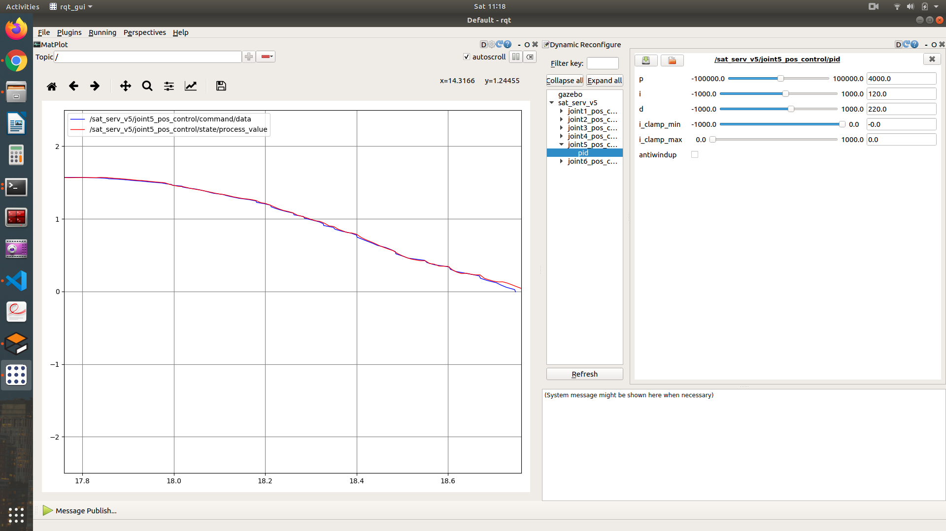
Robot PID Control
Untuned PID Gains (joints 5 & 6)
Tuned PID Gains (joints 5 & 6)

Slide 15
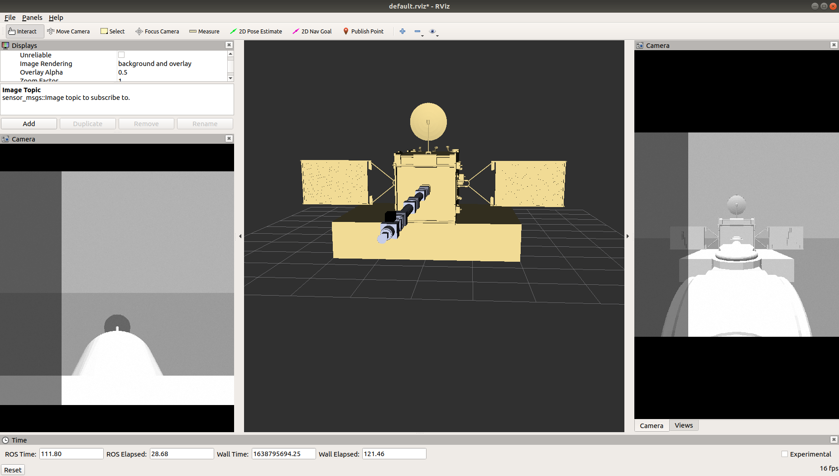
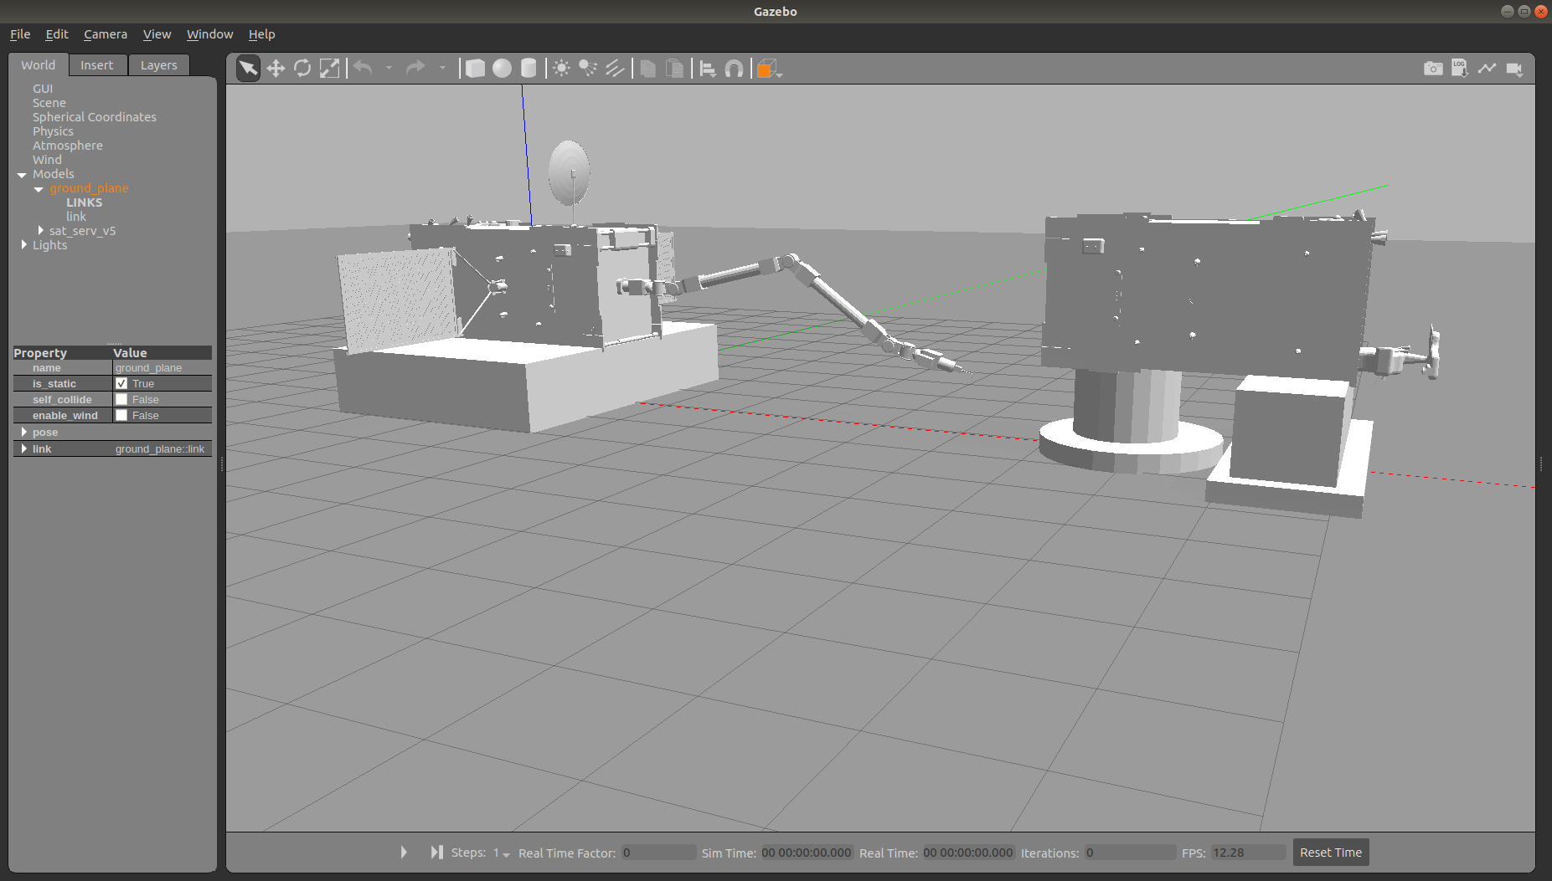
Simulation Setup
(Right) RViz simulation of the system consisting of two camera views (one towards the cutter and the other facing towards the satellite).
(Left) Gazebo simulation of the system consisting of the satellites (servicing & to be serviced) with the robot arm.
The Gazebo environment is configured with low gravity and telemetry delays of ~5 seconds between ‘Earth’ and ‘Space’.

Slide 16

Results (Videos)
Satellite Servicing demo through Teleop
http://drive.google.com/file/d/1mWMDL744PIbxnHuE0x3ZhAkARj0BzSRj/view
Satellite Servicing demo through Move to Points
http://drive.google.com/file/d/1fhbTozlezt9XMjaQBVosvtxVTTh1P1z2/view

Slide 17
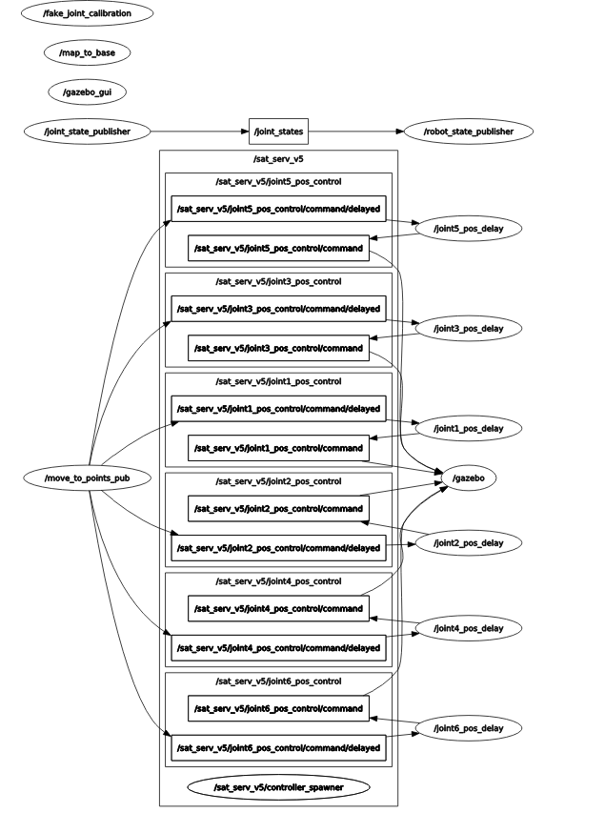
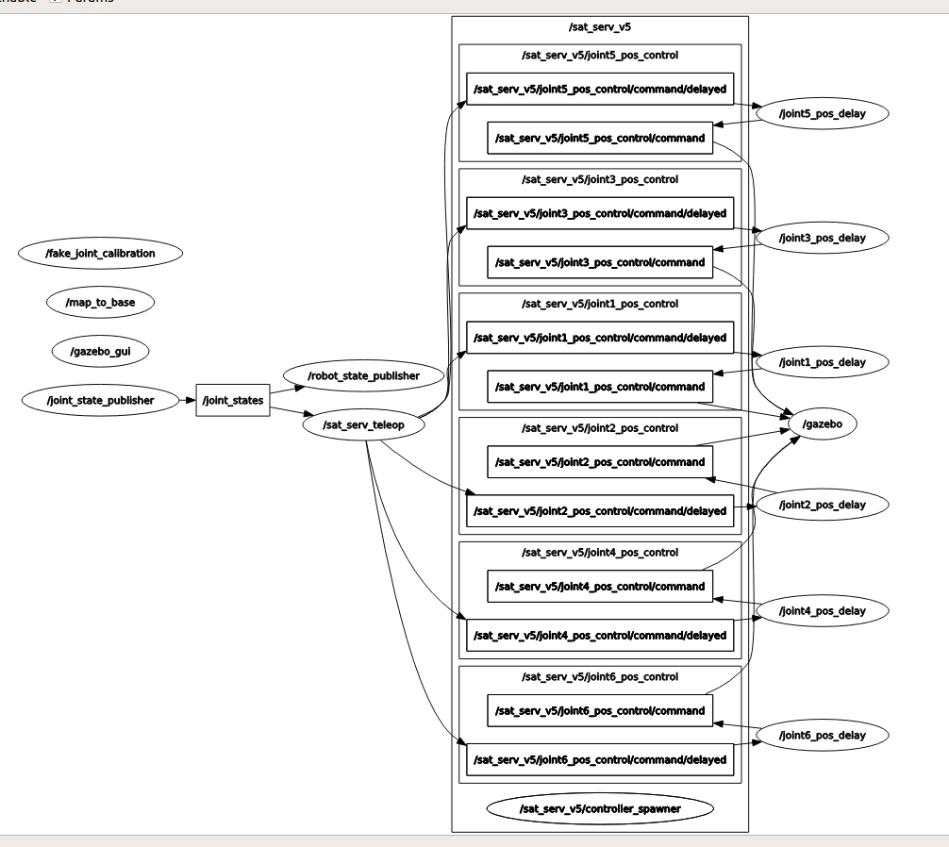
Results (RQT Graphs)
For Satellite Servicing Teleop
For Satellite Servicing Move to Points

Slide 18
Challenges Faced
Simulating the arm in zero gravity means a small impulse due to joint motion shall put the entire assembly into undesirable motion.
Spawning a custom designed manipulator without proper knowledge of joint limits and gravity compensation led to the requirement of high PID gains tuning.
Developing a closed form solution for inverse kinematics of 6 DoF robot manipulators with non-intersecting wrist axes is complicated.
Improper definition of joint axes and coordinate frames to each link in joint in the CAD assembly made our robot to ‘explode’ in simulation.
The weight of the robot is very high and coupled with the long length of the limb, trajectory tracking often has errors as this entire weight is handled by one or two joints in the base.

Slide 19
Conclusion
The proposed prototype service satellite is a hybrid model inspired from various space missions and autonomous systems including the ISSS and ERA respectively. The presented model can reduce the cost of satellite service dramatically and also avoid human intervention thereby saving lives. The proposed telerobot can be used as a pragmatic solution to clear space debris, keeping our cosmos available for future missions.
The prototype can be extended to implementing a part/tool replacement box on the host satellite from which the robot arms can replace the tool on the end-effector based on the servicing operation to be performed.
Also by using the force analysis on the end-effector, we can accurately determine the force required to sturdily grab the satellite to be serviced.

Slide 20
Individual Contribution
Sandeep:
CAD : Base, lower wrist, End effector parts of the Arm
ROS : Teleop script and launch file, generating urdf and zacro files, adding controllers to joints
Adarsh :
CAD : Upper and Lower Limbs, Cutter Apparatus parts of the Arm
ROS : Servicing move script and launch file, time delay script
Common :
DH frame assignment, overall final CAD assembly, Matlab FK/IK validation, workspace, servicing_arm launch file, adding cameras to model

Slide 21
References
On-Orbit Satellite Servicing Study, NASA SSPD Project Report [Online]. Available: https://nexis.gsfc.nasa.gov/images/NASA_Satellite%20Servicing_Project_Report_0511.pdf
NASA GSFC, “Robotic Refueling Mission.” [Online].
Available: https://sspd.gsfc.nasa.gov/RRM3.html
W. Pryor, B. P. Vagvolgyi, W. J. Gallagher, A. Deguet, S. Leonard, L. L. Whitcomb, and P.
Kazanzides, “Experimental evaluation of teleoperation interfaces for cutting of satellite
insulation,” in IEEE Intl. Conf. on Robotics and Automation (ICRA), May 2019, pp. 775–4781
European Robotic Arm (ERA) The International Space Station’s Latest Upgrade, [Online] -
https://esamultimedia.esa.int/docs/science/ERA_brochure_EN_print.pdf
H.J. Cruijssen; M. Ellenbroek; M. Henderson; H. Petersen; P. Verzijden; M. Visser (May 2014). "42nd Aerospace Mechanism Symposium: The European Robotic Arm: A High-Performance Mechanism Finally on its way to Space" (PDF). NASA. pp. 321–323, 329.

Slide 22
Thank You!
Project Code Files: https://drive.google.com/drive/folders/1KleezPnt2n8eWvoP54c76yKUqCBaQALt?usp=sharing

Slide 23
4072 mm
4072 mm
340 mm
1228 mm
340 mm
348 mm
1228 mm

